Slide 1


CGB1201 – JAVA PROGRAMMING
Department of Artificial Intelligence and Data Science
Academic Year: 2024 – 2025 (Odd Semester)
Register Number : 2303811724321120
Name : VENKATACHALAM
Year : II
Semester : III
Section : B
Date : 03/12/2024

Slide 2
SMART PARKING SYSTEM

Slide 3
PROBLEM IDENTIFICATION
Limited Parking Availability:
Difficulty in finding available parking spaces, leading to wasted time and congestion in
parking areas.
Inefficient Parking Management:
Traditional parking systems lack real-time monitoring and data analytics, making it hard
to manage space allocation effectively.
Parking Duration and Pricing Issues:
Unclear or inconsistent pricing models, resulting in overcharging or underpricing for
parking durations.
Lack of Real-Time Information:
Drivers don’t have access to real-time information about space availability, leading to
unnecessary driving and increased traffic.

Slide 4
OBJECTIVE
Objective of Smart Parking System:
Optimize Parking Space Utilization: Efficiently manage available parking spaces in real-time.
Reduce Traffic Congestion: Minimize the time spent searching for parking, reducing overall traffic.
Automate Parking and Payment: Streamline parking reservation and payment processes through automation.
Provide Real-Time Data: Offer accurate, live information on parking availability to users.
Enhance User Convenience: Improve the overall parking experience with easy navigation and seamless payment options.
Promote Environmental Sustainability: Reduce fuel consumption and emissions by minimizing the time spent searching for parking.

Slide 5
PROPOSED ARCHITECTURE
Start
Display Main Menu
User Command
(view/reserve/
vacate)
VACATE
RESERVE
VIEW
Read space ID
Read space ID
Display Available Spaces
Check the Space Availability and reserve
Check if the space is occupied and vacate
Exit

Slide 6
JAVA PROGRAMMING - CONCEPTS USED
Object-Oriented Programming (OOP): For creating modular and reusable code.
JDBC: To interact with the database and perform CRUD (Create, Read, Update, Delete) operations.
Multi-threading: To handle real-time monitoring and updates efficiently.
Swing: For developing a graphical user interface (GUI) that allows users to interact with the system.

Slide 7
LIST OF MODULES
Parking Space Management Module
Monitors and manages available parking spaces in real-time.
Tracks occupancy and availability.
User Access & Authentication Module
Allows users to register, login, and manage their accounts.
Provides role-based access (e.g., user, admin).
Parking Reservation Module
Allows users to reserve parking spaces in advance.
Provides real-time booking confirmation and reminders.

Slide 8
MODULE DESCRIPTION
ParkingSpace Class: This class represents an individual parking space. It contains attributes such as id, isOccupied, and price.
ParkingLot Class: This class manages a collection of ParkingSpace objects. It includes methods to:
addSpace(ParkingSpace space)
displayAvailableSpaces()
reserveSpace(String id)
vacateSpace(String id)
ParkingSystem Class: This is the main class that runs the application. It initializes a ParkingLot instance, adds some parking spaces, and provides a command-line interface for users to interact with the system. Users can view available spaces, reserve a space, vacate a space, or exit the application.

Slide 9
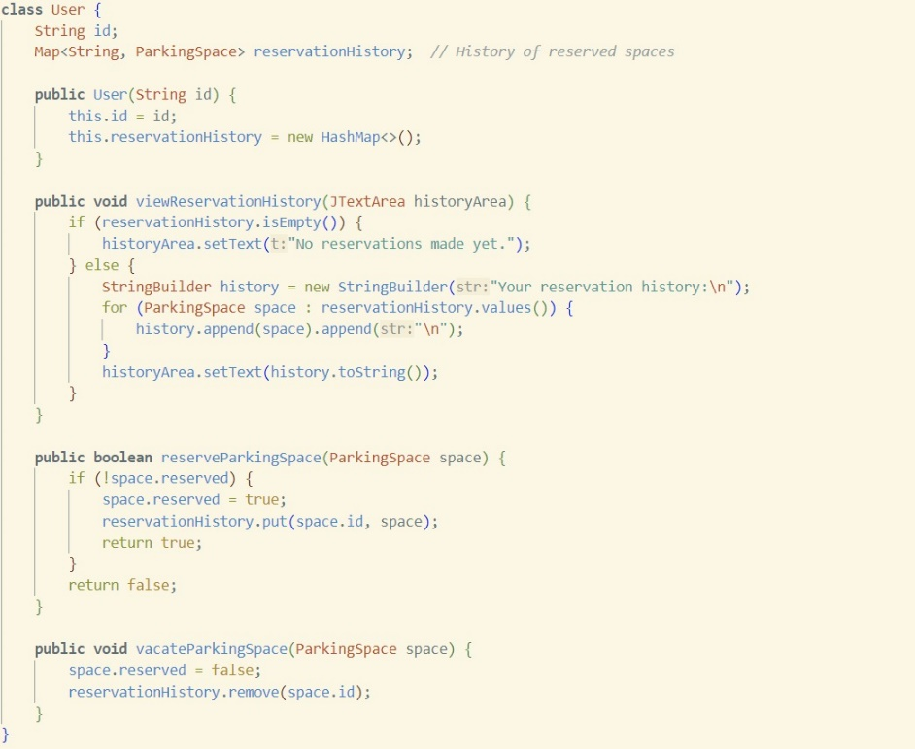
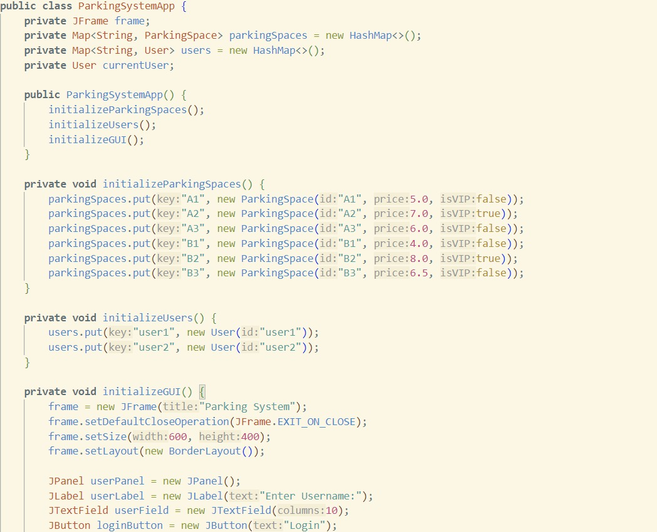
SOURCE CODE

Slide 10
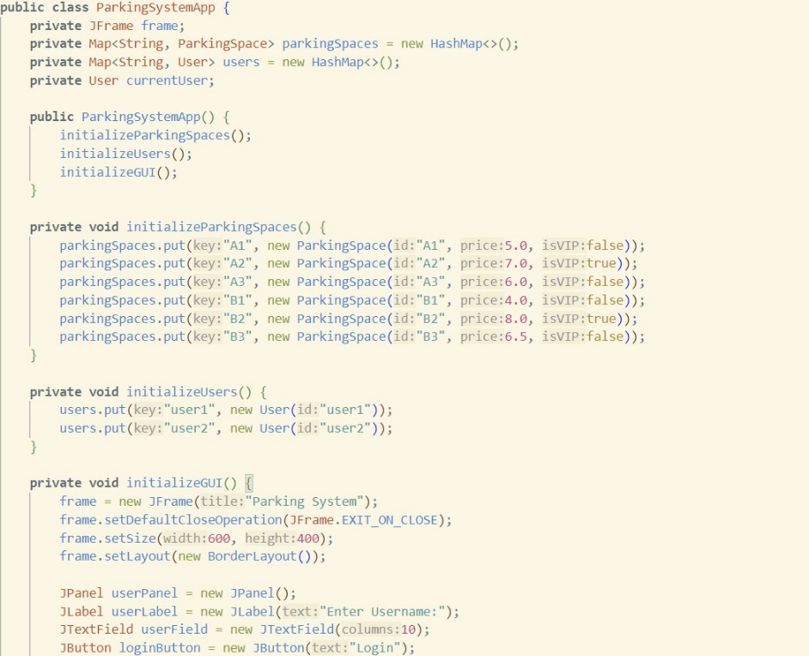
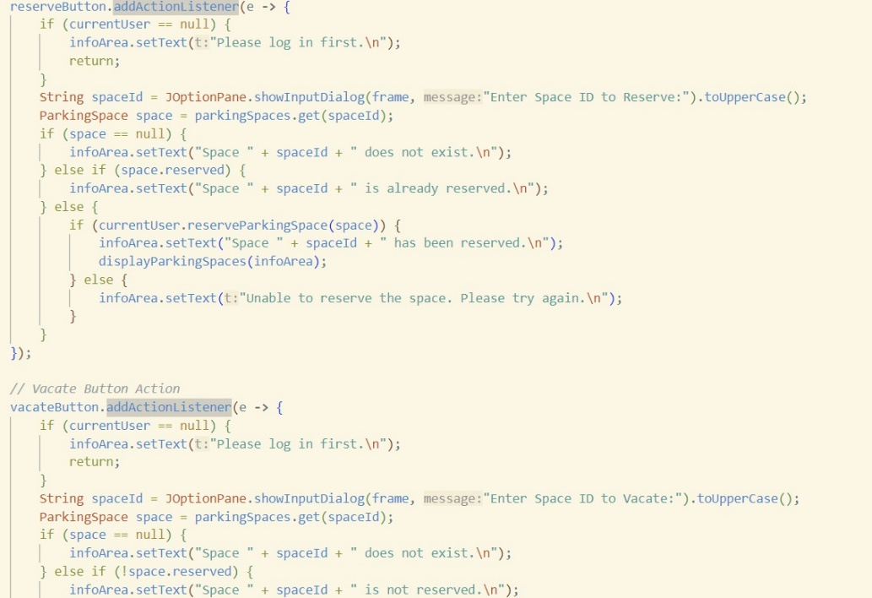
SOURCE CODE

Slide 11
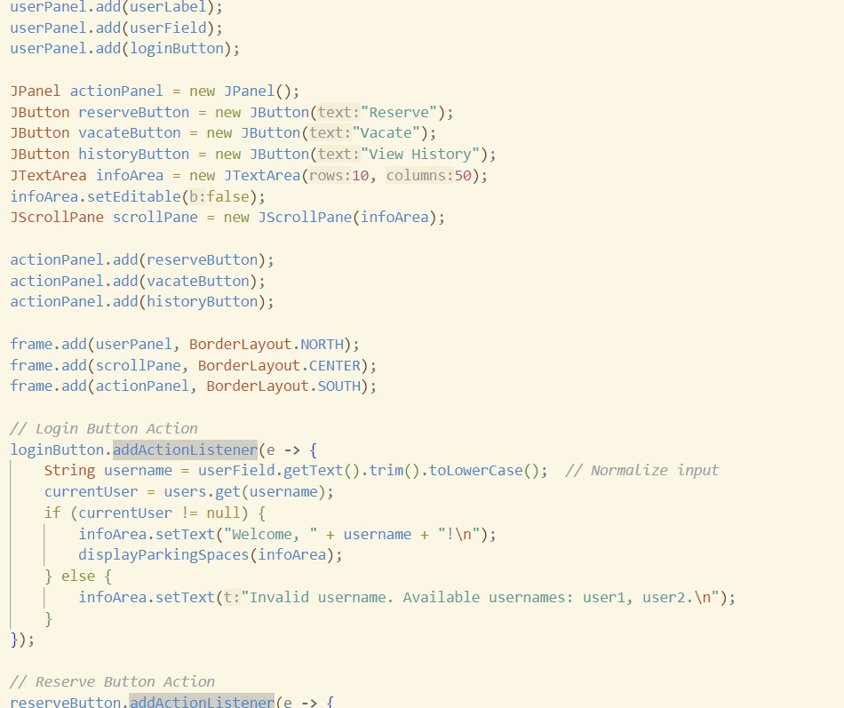
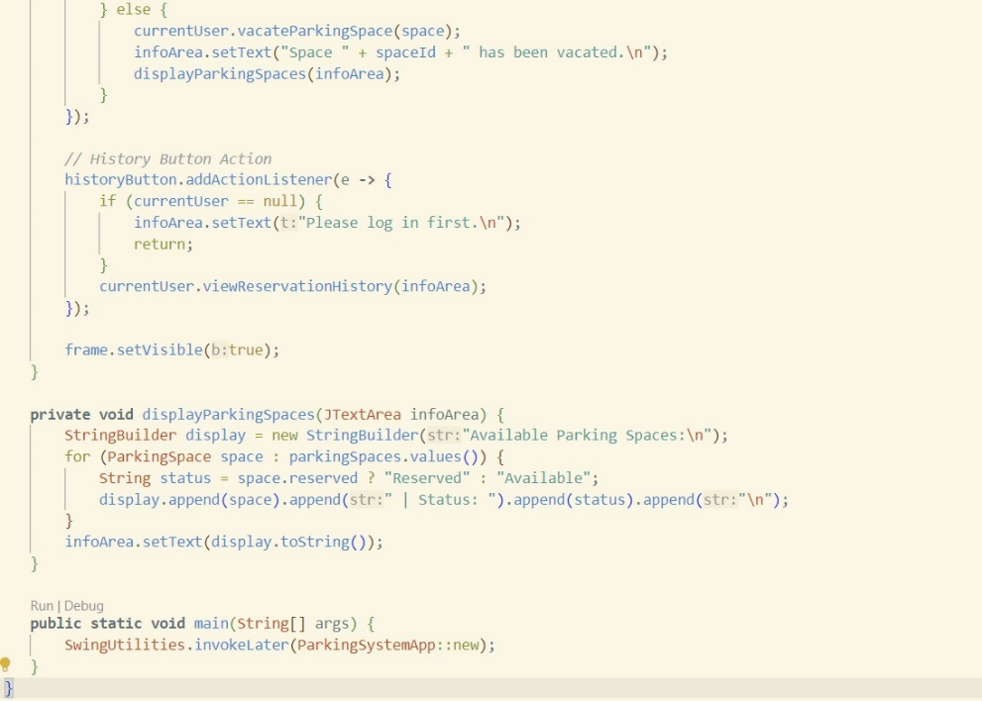
SOURCE CODE

Slide 12
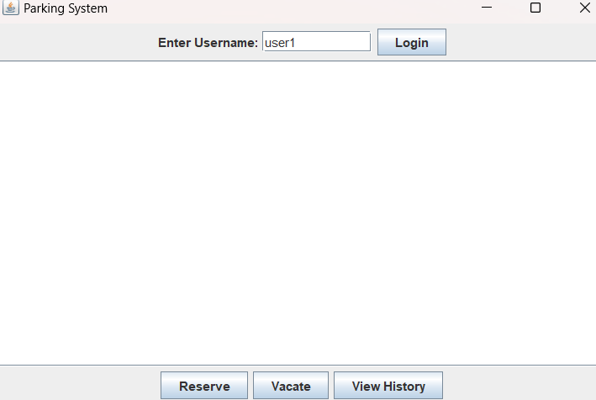
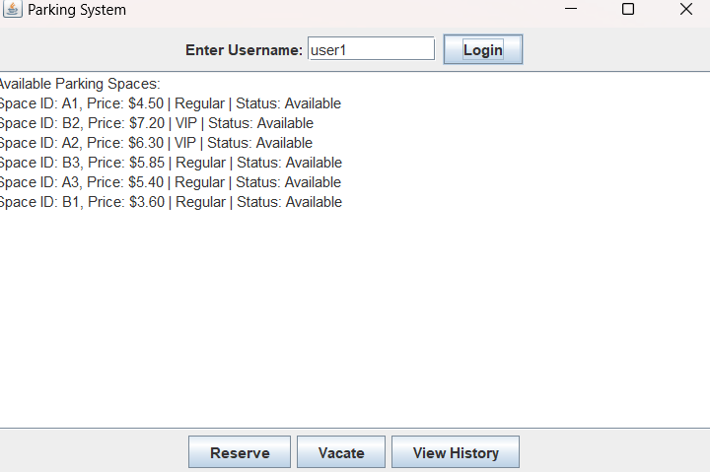
RESULTS AND DISCUSSION

Slide 13
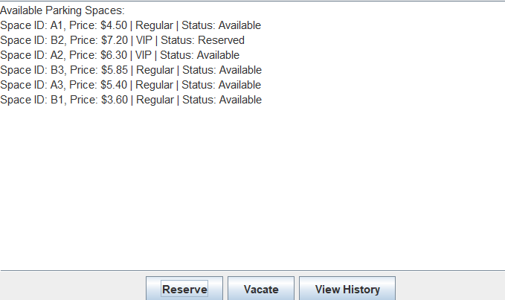
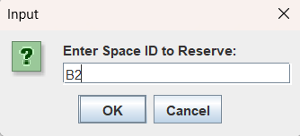
RESULTS AND DISCUSSION

Slide 14
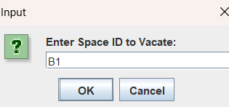
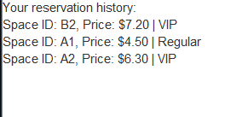
RESULTS AND DISCUSSION

Slide 15
CONCLUSION
The Smart Parking System addresses the common issues faced in traditional parking management. By integrating real-time monitoring, dynamic pricing, and a reservation system, it offers a comprehensive solution that enhances parking space utilization and user experience. Future improvements could include more advanced predictive analytics for even better pricing strategies and integration with mobile applications for broader accessibility.

Slide 16
THANK YOU

